Slide 1
servicenow
Discovery Fundamentals
Jeff Thies
youtube.com/@ServiceNowSimple
jtt0340@gmail.com
servicenowsimple

Slide 2
servicenow
Discovery Fundamentals
Functional / Architectural Overview
MID Servers
Demonstration (Quick Discovery)
Schedules & Credentials
Phases, Probes, Classifications & Patterns
servicenowsimple

Slide 3
What is ServiceNow Discovery?
Discovery is an application on the ServiceNow platform that allows us to find, classify, and identify hardware and software on the network and populate the ServiceNow CMDB.
What is the ServiceNow CMDB?
The CMDB is a set of database tables that provides a logical model of your company’s IT infrastructure including all the components (hardware & software) and how they’re connected and configured to provide services.
servicenowsimple

Slide 4
Populating the CMDB
Manual Entry
Automated Discovery
Integrations
CMDB Tables
servicenowsimple

Slide 5
Populating the CMDB
Manual Entry
Automated Discovery
Integrations
Manually populate and submit ServiceNow forms
A form exists for every type of CI*
Network scanning tools identify and load CIs*
SN Discovery, SN Service Mapping, Microsoft SCCM, etc.
Import from legacy inventory systems
File, JDBC, LDAP, REST, Script
IntegrationHub ETL
* Configuration Item (CI) = Infrastructure Component (Hardware & Software)
servicenowsimple

Slide 6
ServiceNow Discovery Fact Sheet
Discovery is an application that scans a network and finds:
Hardware Devices (Computers, Servers, Routers, etc.)
Applications (Databases, VM’s, Web Servers, Apps.)
Discovery identifies and sets relationships between Applications and Hardware (and Applications and Applications)
Discovery is agent-less, meaning no software needs installed on the discovered devices
servicenowsimple

Slide 7
ServiceNow Discovery Fact Sheet
Discovery is not included as part of the ServiceNow base system
Discovery is one of ServiceNow’s largest application bundles
Discovery Home, Discovery Dashboard, Schedules, Credentials, MID Servers, Discovery Definition, Range Sets, Behaviors, Probes, Sensors, Port Probes, Classifications, etc.
servicenowsimple

Slide 8
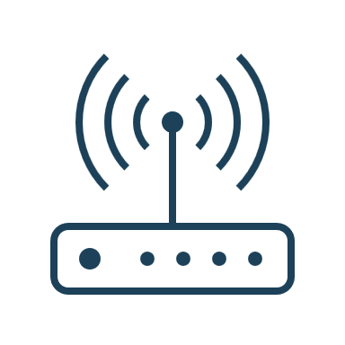
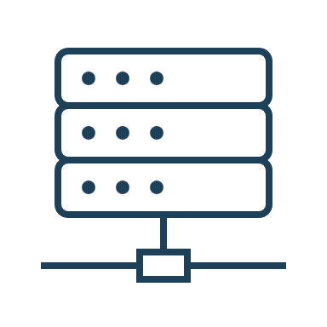
Discovery Architecture
Company Network
ServiceNow
MID Server
ServiceNow
Instance
ECC Queue
Enterprise Firewall
servicenowsimple

Slide 9
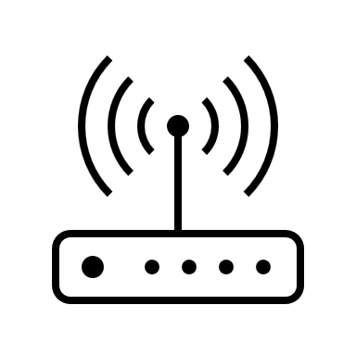
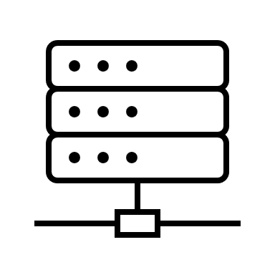
Discovery Architecture
Company Network
MID 1
ServiceNow
Instance
MID 2
Enterprise Firewall
MID 3
servicenowsimple

Slide 10
4 Phases of Discovery
Phase 1
SCANNING
Which devices respond and what ports are open?
Based upon a specified set of IP addresses
Phase 2
CLASSIFICATION
What type of device is this?
Based upon ports discovered in Scanning Phase
Phase 3
IDENTIFICATION
Create new CI or update existing?
Based upon results of Classification Phase
Phase 4
EXPLORATION
What else can we learn?
Based upon results of Classification Phase

