Slide 1
servicenow
Certified System Administrator (CSA)

Slide 2
Intro
Platform
Next Experience
Lists & Filters
Forms
Tasks
Notifications
Access Controls
Tables
Virtual Agent
Flow Designer
Svc Catalog
Knowledge
Mgmt
Reporting
Import
Sets
Data
Policy
CMDB
Catalog Components
Plugins
Scripting
Update
Sets
Wrap-up
Instance Stats
Events
App Dev
App Scope
Integration

Slide 3
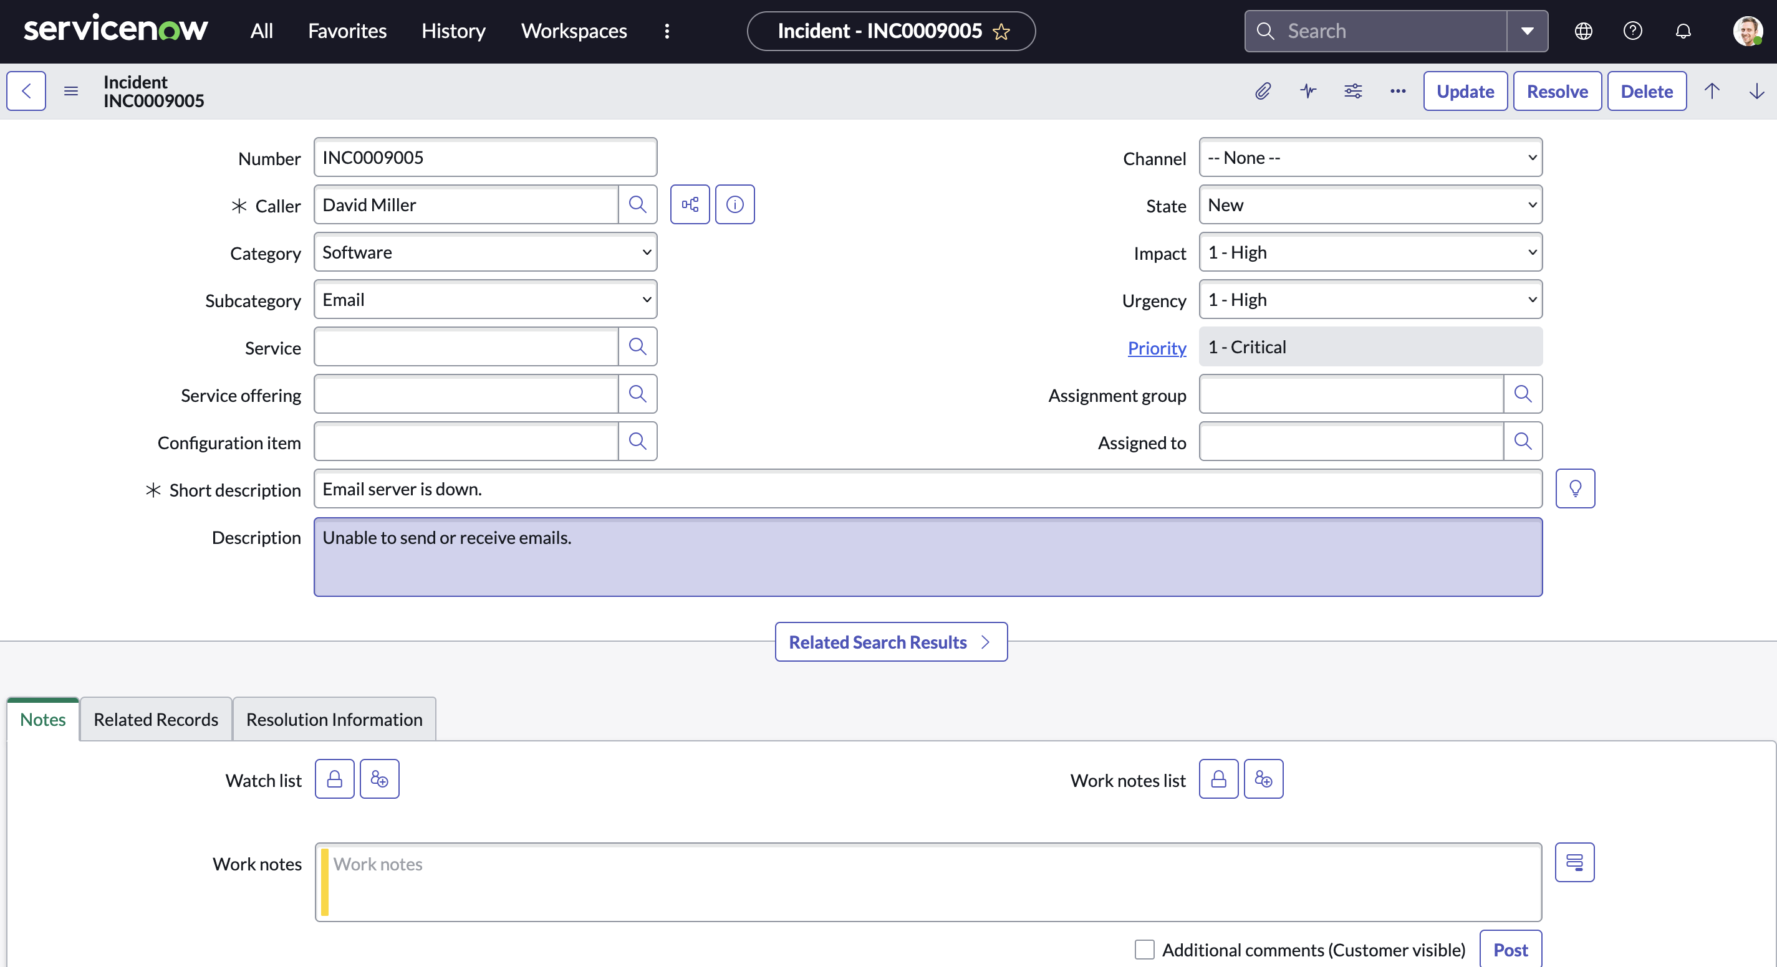
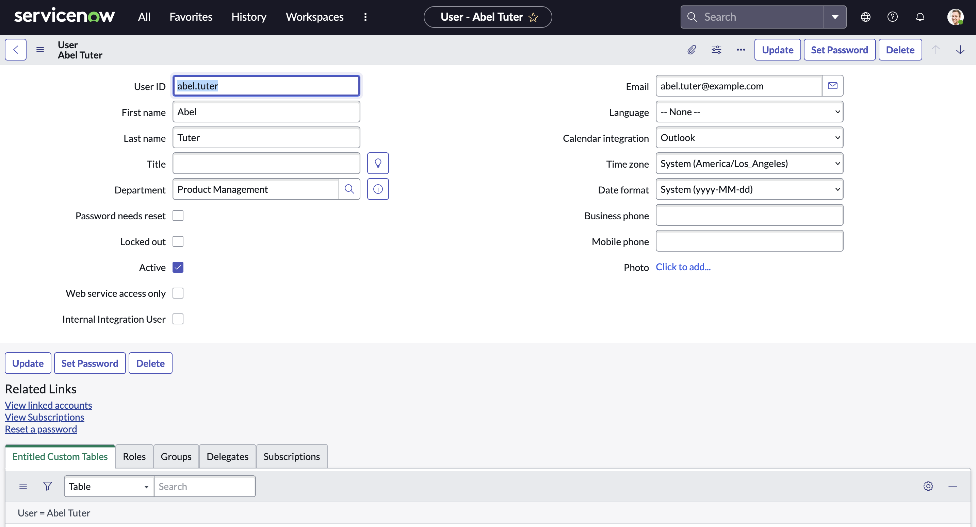
servicenow Forms
A form in ServiceNow is a common set of tools and user-interface elements used to view and update a single record from the database.
Incident Record
User Record

Slide 4
servicenow Forms
Header Bar
Fields
Required
Read-only
Sections
Related Lists
Formatters

Slide 5
servicenow Forms
Form Field Types
String field
Boolean (true/false) field
Choice field
Reference field

Slide 6
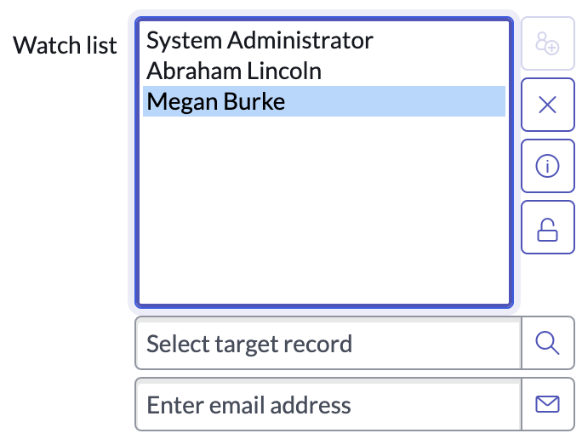
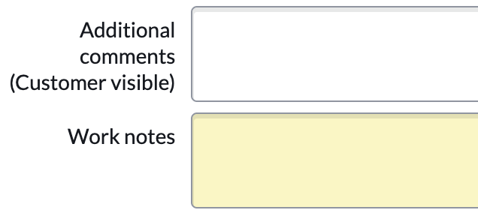
servicenow Forms
Form Field Types
List field
Journal field

Slide 7
servicenow Forms
Form Field Dependencies
Some fields are dependent on other fields.
If State = ‘On Hold’ then
display and require On hold reason

Slide 8
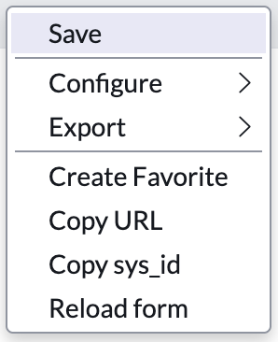
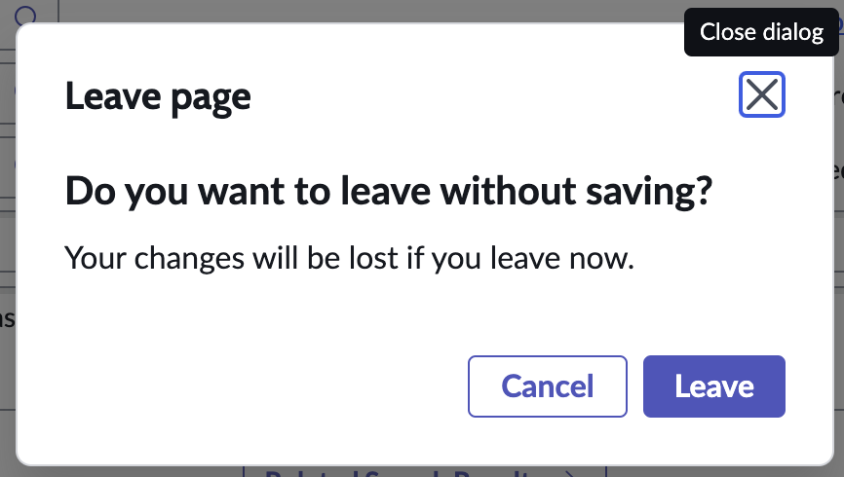
servicenow Forms
Saving Changes
As changes are made on a form, they are NOT automatically saved.
Users must proactively save changes by using the Save menu item or Submit/Update button
If you attempt to leave a form with unsaved changes, the system will provide notification.

Slide 9
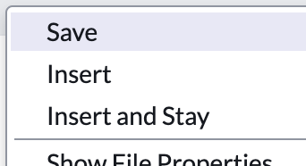
servicenow Forms
Copying a Record
Most forms provides two methods of creating a new record as a copy of an existing one.
Insert: Creates and saves a copy of the current record and returns the user to the list of records
Insert and Stay: Creates and saves a copy of the current record and leaves the user on the new record’s form

Slide 10
servicenow Forms
Form Sections
Forms are made up of Sections that organize the fields and other data.
Sections can be viewed as tabs or expandable sections, depending on the preference of the user.
Tabbed Section
Expandable Section

Slide 11
servicenow Forms
Form Related Lists
A related list is a special form element that displays a list of records from another table that is related to the current record (a one-to-many relationship). For example, a User form might contain a related list displaying all Roles that have been associated with the user.

Slide 12
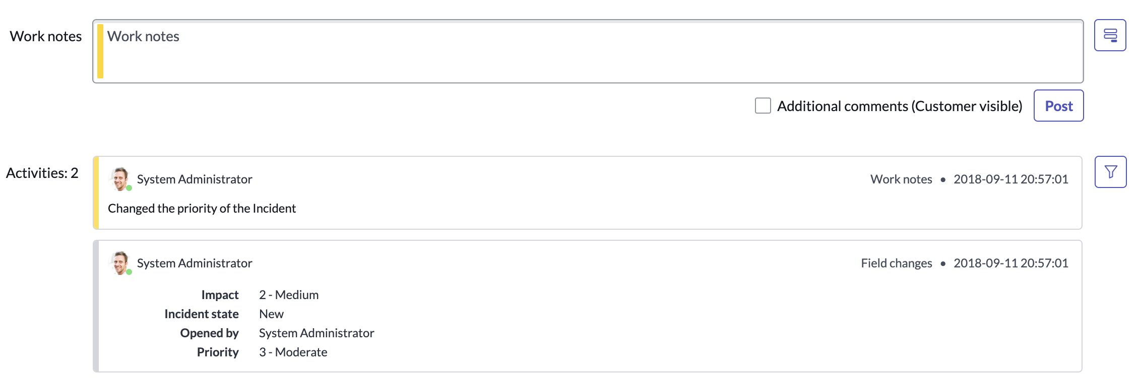
servicenow Forms
Form Formatters
A formatter is a special form element that displays information that is not a field in the record. For example, an Activity Formatter displays the list of activities, or history, on a Task form

Slide 13
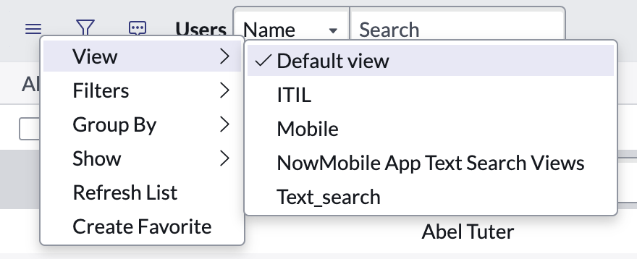
servicenow Forms
Form Views
Not every user wants to see a record’s data in the same way.
Form views provide the ability to display and organize fields, related lists, and formatters in different ways to meet the needs of specific users.

Slide 14
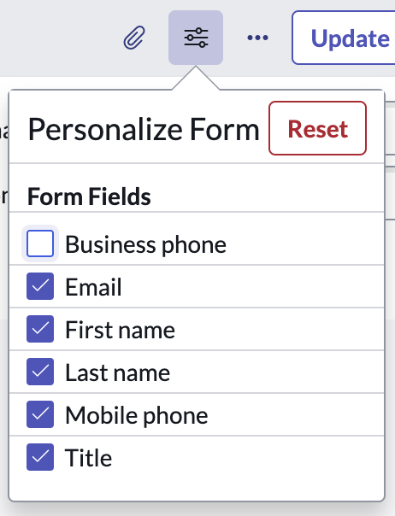
servicenow Forms
Form Personalization
Form personalization allows the user to select which fields are displayed on a particular form view.
These changes do not impact any other users.
Clicking Reset will return the form view to its original settings

Slide 15
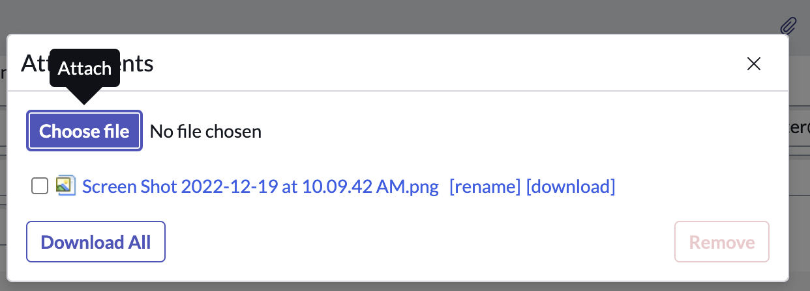
servicenow Forms
Form Attachments
The Manage Attachments button provides the ability to attach files to a record.

Slide 16
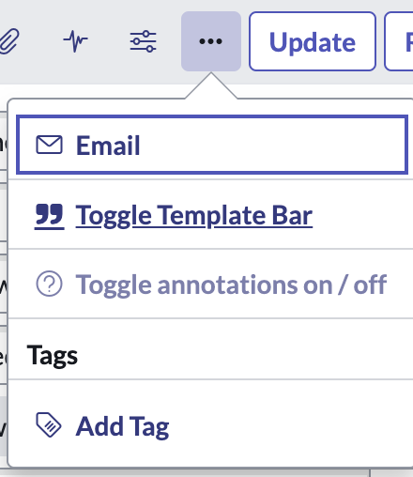
servicenow Forms
Form Templates
Templates are used to simplify the process of creating new records by populating some form fields automatically. The More Options icon provides the ability to toggle on/off the template bar at the bottom of the form.
Any user can toggle on/off the template bar and create templates. The templates a user can access are dependent on the access controls set within each template.

Slide 17
servicenow Forms
Form Templates
The template bar provides shortcuts to apply, edit, and create templates for the current form.
Edit Template
Close Template Bar
Apply Template
Create Template

Slide 18
servicenow Forms
Form Templates
Templates can set the value of fields regardless of their visibility in the form view
The checkmark icon identifies fields modified by an applied template
Field values can include variables (Ex. The logged in user)
Saving a template with the same name as the table it applies to will make it the default template to be applied on every new user-created record

Slide 19
servicenow Forms
Creating & Editing Form Views
Two tools exist for creating and managing form views, both available from the form context menu
(must have admin or personalize_form roles to do this)
The Form Design tool provides a drag-and-drop GUI method of creating views and laying out sections and fields.
The Form Layout tool provides a simpler method of creating views and adding and removing fields.

