Slide 1
ITSM, ITIL, ServiceNow
ServiceNowSimple

Slide 2
Introduction & Hook
When I started working with ServiceNow, I began to read and hear a lot about the importance of ITSM and ITIL.
And, like any good IT professional, I confidently smiled, and nodded my head, as if I knew exactly what those things were. I had no idea.
But, I’ve learned, and it’s really not that difficult.
In this video I’m going to tell you just enough to be dangerous about ITIL, ITSM, and how they relate to ServiceNow.

Slide 3
Channel Introduction
Hey, it’s Jeff Thies from ServiceNowSimple where we help you understand the ins-and-outs of ServiceNow, keeping it simple all the way.
We’re glad you’re here and hope you will consider joining the channel so you can get notified as we add new content.
As always, I’ll include links in the description box below to any of the resources I mention in this video.
Now, let’s get SIMPLE with ITIL, ITSM, and ServiceNow.

Slide 4
Information Technology Service Management (ITSM)
Information Technology: Hardware, Software
Service: The exchange of a business problem/opportunity with an IT-based solution
Management: The activity of ensuring IT Services are creating maximum VALUE
ITSM is the activity of ensuring that an organization’s IT deliver solutions (services) that produce maximum value.

Slide 5
IT Infrastructure Library (ITIL)
ITIL is a published set of best practices on how to get better at ITSM
Initially published by Great Britain’s Central Computing and Telecommunications Agency (CCTA) in 1989
Owned by Axelos since 2014 (https://www.axelos.com/certifications/itil-service-management/what-is-itil)
Most current version is ITIL Version 4, published in 2019

Slide 6
ITIL Value Concepts
Value is co-created
An exchange where all involved benefit
One-way value is rarely a good thing (Ex. slavery, selfishness)
Output vs Outcome
Output is a deliverable from some activity
Outcome measures the usefulness of an output; is it what was needed?

Slide 7
ITIL Value Concepts
Utility & Warranty
Utility is what something does; how it is utilized; it’s intended purpose
Warranty is how it does it; is it quality, secure, dependable, available, safe?
To be valuable, a service must have both Utility and Warranty

Slide 8
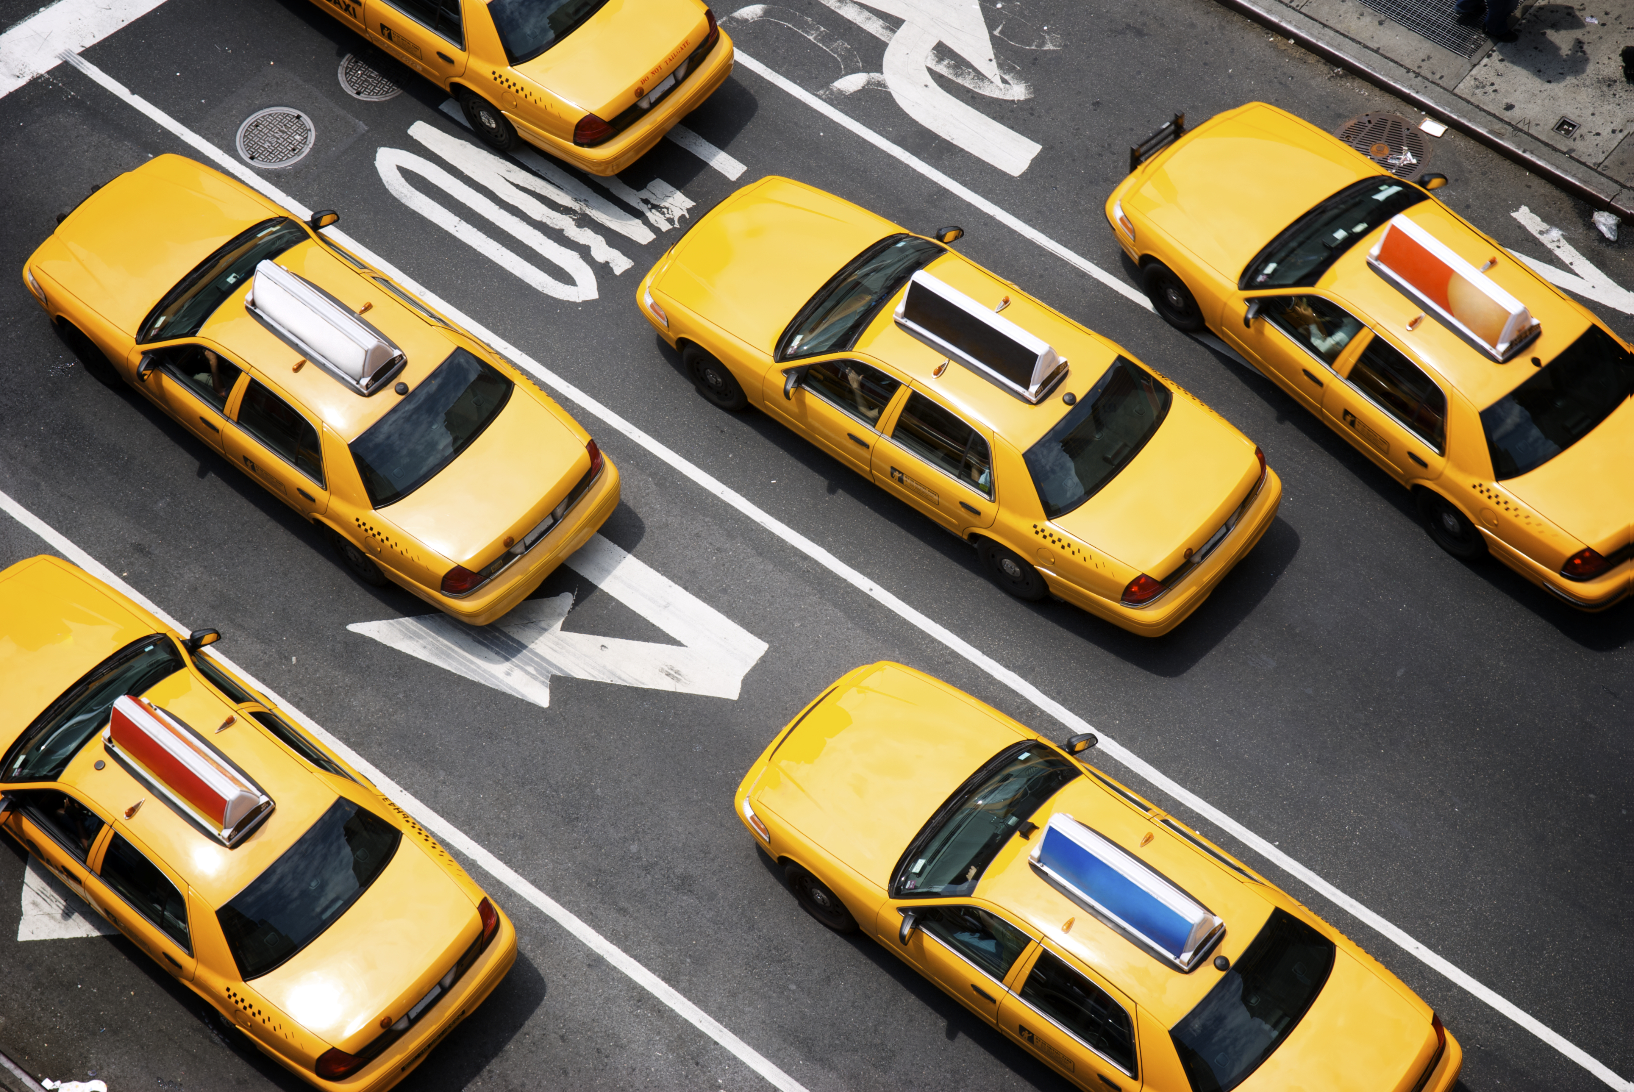
ITIL Service Concepts
Service
Co-creation of value by facilitating outcomes customers want to achieve, without them having to manage specific costs and risks
Service Offering
A formal description of 1 or more services, designed to address the needs of a particular group of people usually involving an exchange of goods, access to resources, or service actions

Slide 9
ITIL Service Concepts
Service Management
A set of specialized organizational capabilities for enabling value for customers in the form of services
Service Relationship
A cooperation between a service provider and a service customer; they include the provision of the service, consumption of the service, and service relationship management;

Slide 10
ITIL People Concepts
Organization
A person or group of people that has its own functions with responsibilities, authorities, and relationships to achieve its objectives;
Organizations will be both service providers and service consumers
Service Consumer Roles
Customer: Defines the service requirements and understands the big picture
User: The one using the service
Sponsor: The one approving the purchase or service relationship

Slide 11
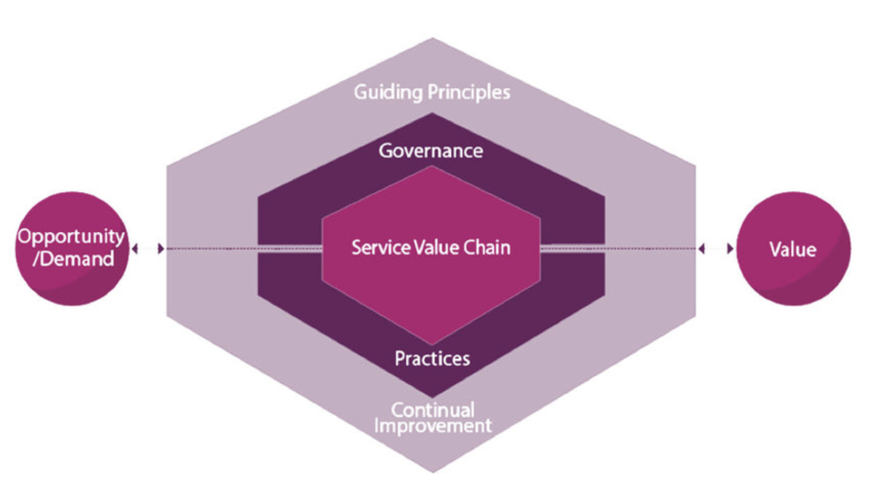
ITIL’s Service Value System
Governance: Setting and enforcing rules
Guiding Principals: Recommendations of approaches that help us get things right
Service Value Chain: A set of activities that we perform to deliver something
Practices: Things we do to produce useful work
Continual Improvement: Getting better all the time

Slide 12
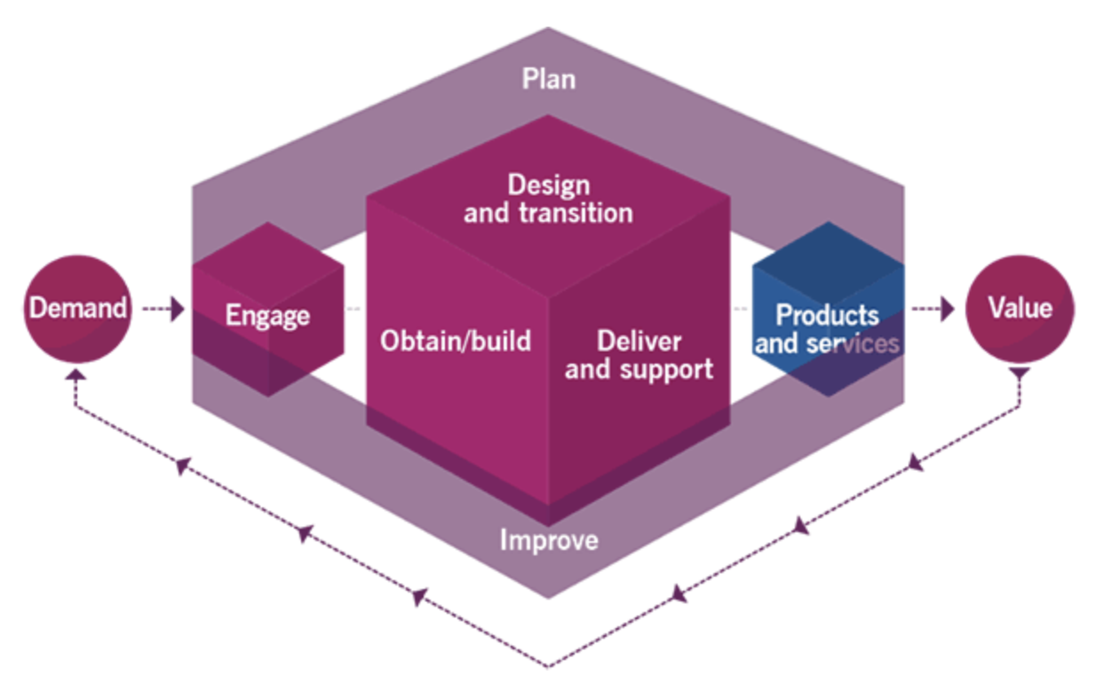
Service Value Chains
Plan: Ensure a shared understanding of the demand/opportunity
Improve: The plan should identify the improvement/benefit
Design & Transition: Ensure expectations are met (quality, costs, time to market, etc.)
Engage: Build a maintain a good relationship with all stakeholders

Slide 13
Service Value Chains
Obtain/Build: Obtain/build the components of the service;
Deliver & Support: Ensure the services are delivered and supported according to expectations
The Products and Services are the end results that deliver the value

Slide 14
The 7 ITIL Guiding Principles
Focus on Value: Everything you do should link back to value, otherwise, don’t do it
Start Where You Are: Don’t stop doing what you're doing well; build from where you are
Progress Iteratively With Feedback: Break improvements down to small things that provide value; try things out, see if they are better, incorporate, and adjust accordingly
Collaborate and Promote Visibility: We work together; involve the right people; keep everyone in the loop; share knowledge and skills
Think and Work Holistically: Specialization is ok, but make sure everyone knows the big picture; be willing to take on other roles;
Keep it Simple and Practical: Be as efficient as possible; the best way is the easiest way, all other things being equal
Optimize and Automate: Make things as effective and useful as needed; good enough is good enough; use technology without human intervention whenever possible; machines are better than people in some situations

Slide 15
End
ServiceNowSimple

