Slide 1
Lesson 2: ServiceNow Platform Overview
Now Platform Architecture
Applications and Workflows
User Interfaces
Role-based Access & Authentication
ServiceNowSimple.com

Slide 2
Meet Fred Luddy
Lesson 2: ServiceNow Platform Overview
ServiceNow was founded by Fred Luddy in 2004 to ”automate the flow of work throughout a business”
How awesome would it be if the businesspeople themselves could solve their own business problems using technology that was straightforward, intuitive, and simple?
Fred attended Indiana University but dropped out before graduating.
As of 11/22/2021, Fred Luddy has a net worth of 1.3 billion dollars.
ServiceNowSimple.com

Slide 3
The Now Platform
Lesson 2: ServiceNow Platform Overview
The Now Platform is an Application Platform as a Service (APaaS).
ServiceNow is a cloud-based.
ServiceNow provides and supports the infrastructure computer resources.
ServiceNow provides a platform upon which you can develop your own custom solutions.
ServiceNow provides a robust set of applications and workflows to support most common business processes.
All applications (OOB and custom) for the entire enterprise are supported by a single, common, data-model and database.
ServiceNowSimple.com

Slide 4
Applications and Workflows
Lesson 2: ServiceNow Platform Overview
ServiceNow comes with a robust suite of applications which are categorized (functionally) into 4 primary workflows:
IT Workflows: 79 applications that support internal IT functions
Employee Workflows: 43 applications targeted at the needs of employees
Customer Workflows: 93 applications that support functions related to customers
Creator Workflows: 23 applications designed to enable ServiceNow platform development and operations support
ServiceNowSimple.com

Slide 5
Applications and Workflows
Lesson 2: ServiceNow Platform Overview
IT Workflows
IT Service Management (24)
IT Operations Management (13)
IT Business Management (10)
IT Asset Management (4)
DevOps (4)
Security Operations (8)
Governance, Risk, and Compliance (13)
Telecommunications Network Performance Management (3)
Employee Workflows
HR Service Delivery (16)
Workplace Service Delivery (10)
Legal Service Delivery (10)
Procurement Service Management (6)
Safe Workplace Suite (1)
Customer Workflows
Customer Service Management (29)
Field Service Management (11)
Connected Operations (4)
Financial Service Operations (25)
Telecommunications Service Management (24)
Creator Workflows
App Engine (15)
IntegrationHub (8)
ServiceNowSimple.com

Slide 6
Now Platform Architecture
Lesson 2: ServiceNow Platform Overview
When you purchase an instance, it is ServiceNow’s responsibility to support the IT infrastructure and compute resources needed to enable and secure that instance.
Enterprise Cloud
Most cloud services are built on a multi-tenant architecture in which your platform and data are co-mingled with other companies. ServiceNow is built on a multi-instance architecture. You have your own instance of the platform and database.
Availability & Redundancy
All ServiceNow datacenters are paired with another datacenter to provide redundancy and failover. Redundancy is built into every layer including devices, power, and network resources.
ServiceNowSimple.com

Slide 7
Now Platform Architecture (2)
Lesson 2: ServiceNow Platform Overview
When you purchase an instance, it is ServiceNow’s responsibility to support the IT infrastructure and compute resources needed to enable and secure that instance.
Backups & Security
ServiceNow provides 4 weekly full data backups and 6 days of daily differential backups. The entire platform Is secured using multiple technologies which have been certified by third-party security organizations.
Domain Separation (multi-tenancy)
The ServiceNow platform provides the ability to separate data, processes, and administrative tasks on an instance into logical groupings called domains.
All users can potentially see records from the ‘global domain’, but only users who belong to a domain can see domain-specific records.
ServiceNowSimple.com

Slide 8
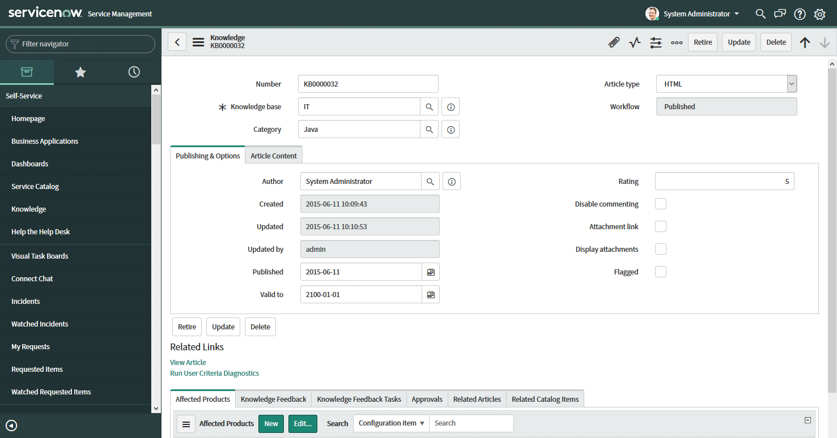
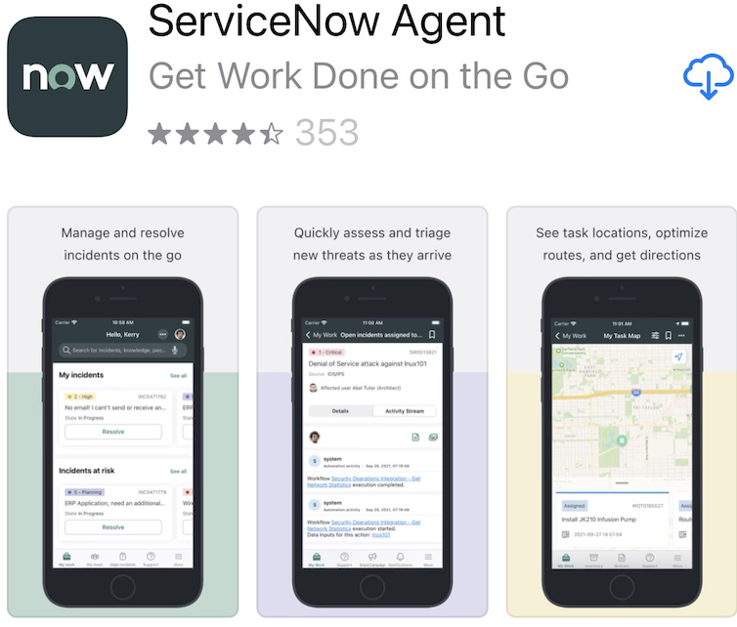
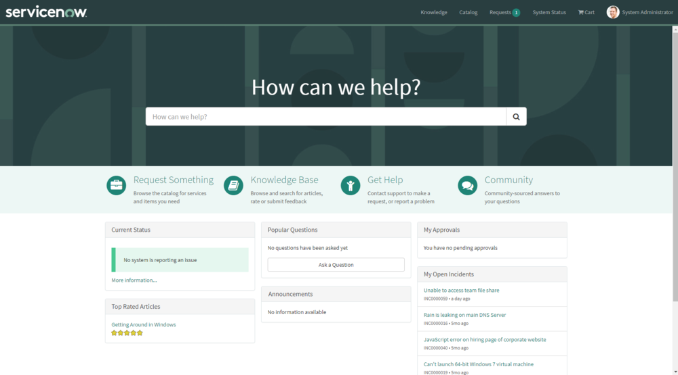
Now Platform User-interfaces
Lesson 2: ServiceNow Platform Overview
ServiceNow provides 3 user-interfaces for interacting with the Now platform.
The Now Platform UI us the primary UI. It is best used on desktop and laptop computers and is accessed via a web-browser and the instance URL.
The ServiceNow Mobile Apps are best used on mobile devices and can be installed from the device’s app store. The ServiceNow Agent app targets fulfilling requests. The Now Mobile app is built for the needs of employees. The ServiceNow Onboarding app targets the needs of new-hire employees.
The Service Portal is a user-friendly, self-service, widget-based portal accessed via a web-browser and special URL.
ServiceNowSimple.com

Slide 9
Role-based Access
Lesson 2: ServiceNow Platform Overview
Not every member of an organization needs access to all information all the time. ServiceNow uses role-based access to ensure a user can get the information they need, and no more. The primary components include:
A User is an individual that has been given access to an instance. Users are usually assigned to 1 or more groups and can be granted multiple roles. A user with no roles assigned is called a self-service user. They can login and access actions like viewing the homepage, Service Catalog, articles, and surveys.
A Group is a set of users who share a common purpose and need access to similar data. Multiple roles can be assigned to a single group.
A Role is a collection of permissions. A role can be assigned to an individual user, a group of users, or another role. Multiple roles can be assigned to a single role. It’s best to assign roles to a group rather than an individual user.
ServiceNowSimple.com

Slide 10
User Authentication
Lesson 2: ServiceNow Platform Overview
When a user attempts to login to an instance, ServiceNow validates their identity and enables access to functions and data based upon their related groups and roles. The platform can support several methods of user authentication including:
Local database authentication
External Single Sign-on (SSO)
LDAP
OAuth 2.0
Digest Token
Multi-factor Authentication
ServiceNowSimple.com

Slide 11
Lesson 2 Complete
ServiceNowSimple.com

