Slide 1
What is CMDB?
ServiceNowSimple

Slide 2

What is CMDB?
Configuration Management DataBase
What is that?
CMDB

Slide 3
What is Configuration Management?
IT is
Critical

Slide 4
What is Configuration Management?
IT is
Critical
IT is
Expensive

Slide 5
What is Configuration Management?
IT is
Critical &
Expensive
IT is
Critical
IT is
Expensive

Slide 6

What is Configuration Management?
IT is
Critical &
Expensive
IT is
Critical
IT is
Expensive

Slide 7

What is Configuration Management?
Configuration
Management
IT is
Critical &
Expensive
IT is
Critical
IT is
Expensive

Slide 8
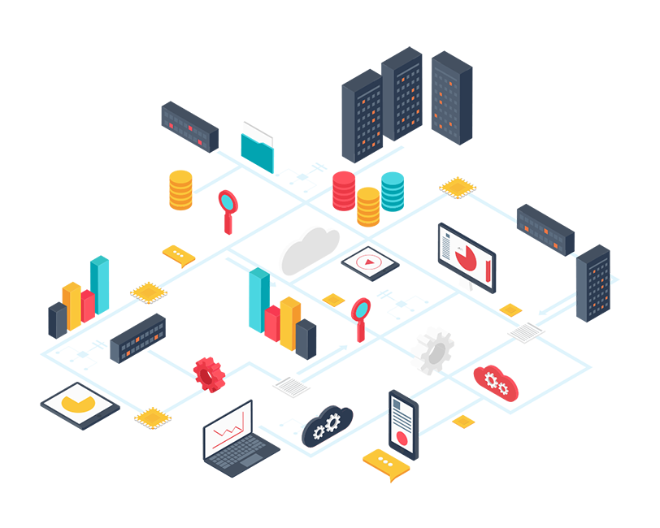
Configuration Management
What IT assets do we have?

Slide 9
Configuration Management
How old are they?
What versions?

Slide 10
Configuration Management
Where are they located?

Slide 11
Configuration Management
How are they being used, and why?

Slide 12
Configuration Management
Is our IT healthy?

Slide 13
Configuration Management
How are our IT components related?

Slide 14
Configuration Management
What if a component changes or fails?

Slide 15
Configuration Management

Slide 16
Configuration Management

Slide 17
Configuration Management

Slide 18
Configuration Management

Slide 19
Configuration Management
Notes:
Dependencies on cloud infrastructure and services provided by CSP’s

Slide 20
Configuration Management

Slide 21
Configuration Management
HELP!!!!!

Slide 22
What is CMDB?
I have a few questions…
A Configuration Management Database is a warehouse of data describing an organization’s IT assets and how they are configured and work together to provide value to the company.
The Configuration Management process depends on the CMDB to answer the questions we just discussed.
CMDB
Notes:
Now that we know a bit about Configuration Management, let’s return to our definition of a Configuration Management Database (CMDB).
A Configuration Management Database is a warehouse of data describing an organization’s IT assets, and how they are configured, and connected to provide value to the company.
The Configuration Management process depends on the CMDB to answer the questions we just discussed.

Slide 23
Classes, CI’s, Attributes
CMDB
Hardware
Software
Notes:
As with any database, a CMDB is a collection of tables that are used to store related records.
For example, you might have a Hardware table to store all Hardware items, and a Software table to store all Software items.
In ServiceNow’s implementation of CMDB, the tables are also referred to as classes.
So, in our example, there would be a CMDB Class named Hardware and a CMDB Class named Software.
Probably the best way to think of it is, every CMDB Class is implemented as a table in the database.
They are essentially the same thing, so don’t get hung up on it.

Slide 24
Classes, CI’s, Attributes
CMDB
Hardware
Name | Serial # | Location
ComputerA | Z101 | Loc1
Printer1 | XR11 | Loc2
Router2 | JJ23 | Loc2
ComputerB | S11 | Loc1
CIs (4)
Attributes (3)
Notes:
Also, just like any database, every Table in the CMDB is comprised of rows and columns of data. Each row, or record, of a table is called a Configuration Item or CI. Each column of a table is called an attribute or property.
So, to expand on our example, we might have a CMDB class named Hardware that is used to store all Hardware.
That class is implemented in the database as a table named Hardware.
Within that table, we might populate 4 records. That would mean we have 4 Hardware Configuration Items.
Each of those Hardware CIs would have multiple attributes describing them, things like Name, Serial Number, and Location.

Slide 25
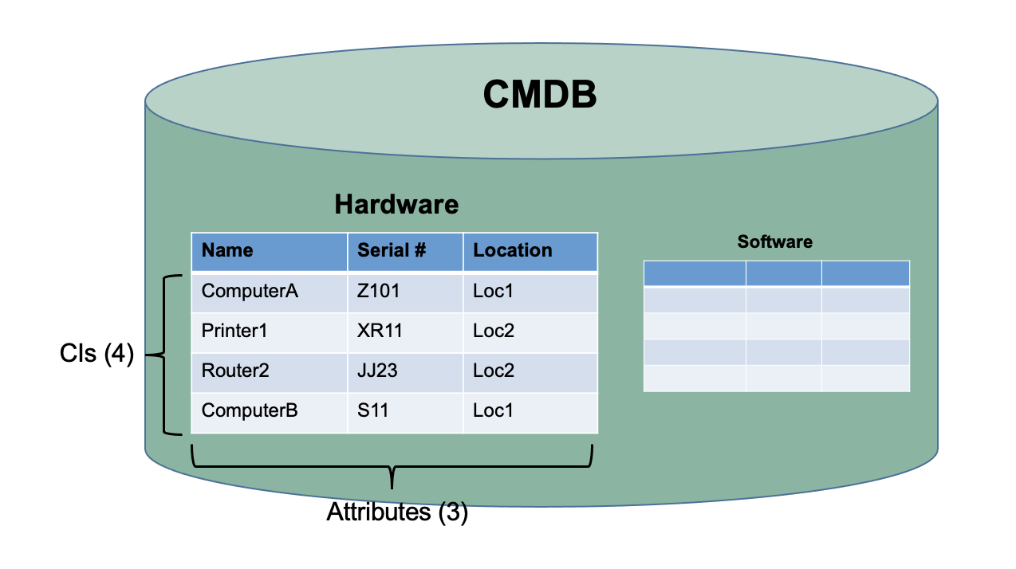
Classes, CI’s, Attributes
How many hardware CIs?
Notes:
Now, our Configuration Management process can rely on the CMDB to answer questions, like:
How many hardware components do we have? Answer: 4
Where is the hardware component with Serial Number Z101 deployed? Answer: Loc1
How many hardware components do we have in our Loc2 datacenter? Answer: 2

Slide 26
CMDB Class Hierarchy
CMDB
Hardware
Software
Notes:
Up to this point, our CMDB example is pretty simple. We have a class for Hardware and a class for Software.
That’s probably not going to provide the detail we need to support our Configuration Management process.
Let’s go a step further and look at how a CMDB is built using a class hierarchy to provide a robust set of classes to support all our different types of Configuration Items.

Slide 27
CMDB Class Hierarchy
Hardware
Name | Serial # | Location
Network Gear
Ports | Channels | Bandwidth
Computer
HDD | OS | RAM
Printer
PPM | Color Ind | Print Type
Personal Computer
Attr1 | Attr2 | Attr3
Mainframe
Attr1 | Attr2 | Attr3
Server
Attr1 | Attr2 | Attr3
Notes:
To do that, ServiceNow’s CMDB has implemented a database design that provides the ability for Classes or Tables to extend each other. It’s called a hierarchical database design.
Let’s assume that our company has invested in Hardware IT components including Network Gear, Computers, and Printers. Using table extensions, we can setup our CMDB with the following structure.
Our Hardware class can be extended by 3 additional classes, Network Gear, Computer, and Printer.
With table extensions, each of those child classes inherits the attributes of the parent Hardware class, so they all have Name, Serial #, and Location attributes.
They can then add additional attributes specific to the type of item. The Computer class, for example, can add attributes to store the Disk Size, Operating System, and available RAM of each computer.
And the fun doesn’t stop there. Each child class can be extended to create children of their own.
For example, the Computer class can be extended to create more specific classes, like Personal Computer, Mainframe, and Server.
Again, the attributes form all parent classes are inherited, and additional attributes can be added.
The ServiceNow CMDB has no limit on the number of table extensions. It’s all up to the needs of the business.

Slide 28
CMDB Class Hierarchy
Hardware
Name | Serial # | Location
xxx | xxx | xxx
Network Gear
Ports | Channels | Bandwidth
Computer
HDD | OS | RAM
xxx | xxx | xxx
Printer
PPM | Color Ind | Print Type
Personal Computer
Attr1 | Attr2 | Attr3
Mainframe
Attr1 | Attr2 | Attr3
Server
Attr1 | Attr2 | Attr3
xxx | xxx | xxx
Notes:
We’re a bit in the weeds here, but let’s take a quick look at how this actually works at the database level.
When a new Server CI is added to the CMDB, there are actually 3 records being inserted into three different tables.
Server specific attributes are inserted into the Server table.

Slide 29
CMDB Class Hierarchy
Hardware
Name | Serial # | Location
xxx | xxx | xxx
Network Gear
Ports | Channels | Bandwidth
Computer
HDD | OS | RAM
xxx | xxx | xxx
Printer
PPM | Color Ind | Print Type
Personal Computer
Attr1 | Attr2 | Attr3
Mainframe
Attr1 | Attr2 | Attr3
Server
Attr1 | Attr2 | Attr3
xxx | xxx | xxx
Notes:
More general Computer attributes are inserted into the Computer table.

Slide 30
CMDB Class Hierarchy
Hardware
Name | Serial # | Location
xxx | xxx | xxx
Network Gear
Ports | Channels | Bandwidth
Computer
HDD | OS | RAM
xxx | xxx | xxx
Printer
PPM | Color Ind | Print Type
Personal Computer
Attr1 | Attr2 | Attr3
Mainframe
Attr1 | Attr2 | Attr3
Server
Attr1 | Attr2 | Attr3
xxx | xxx | xxx
Notes:
Even more generic Hardware attributes are inserted into the Hardware table.
A common ID, called a SYS_ID is used to link the records together, allowing the ServiceNow UI to display the Server item as a single CI.
(STOP)

Slide 31

CI Relationships
In most cases, IT components (CIs) are not fully productive by themselves. CIs work together with other Cis in order to create value.
Notes:
In most cases, IT components or CI’s are not fully productive by themselves.
For that reason, ServiceNow’s CMDB also stores the relationships between the CI’s; How they work together and depend upon each other to create value.
A computer, for example, doesn’t create much value by itself.

Slide 32
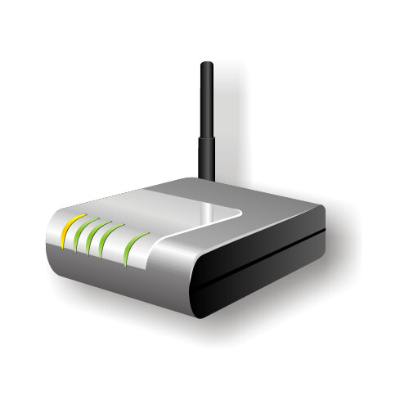
CI Relationships
In most cases, IT components (CIs) are not fully productive by themselves. CIs work together with other Cis in order to create value.
Notes:
One of the first things we normally do to boost the value of a computer is connect it to some Network Gear, like a Router, to establish a connection with our network or the internet.

Slide 33
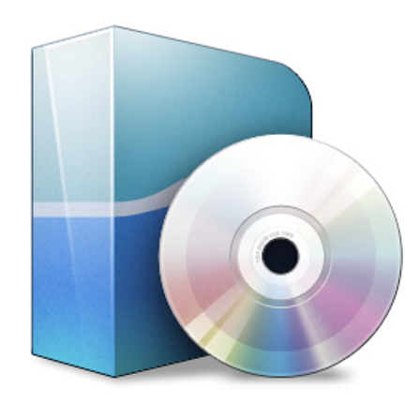
CI Relationships
In most cases, IT components (CIs) are not fully productive by themselves. CIs work together with other Cis in order to create value.
Notes:
Further, to be useful, our new computer depends on Software to provide functionality, like some business application, for example.

Slide 34
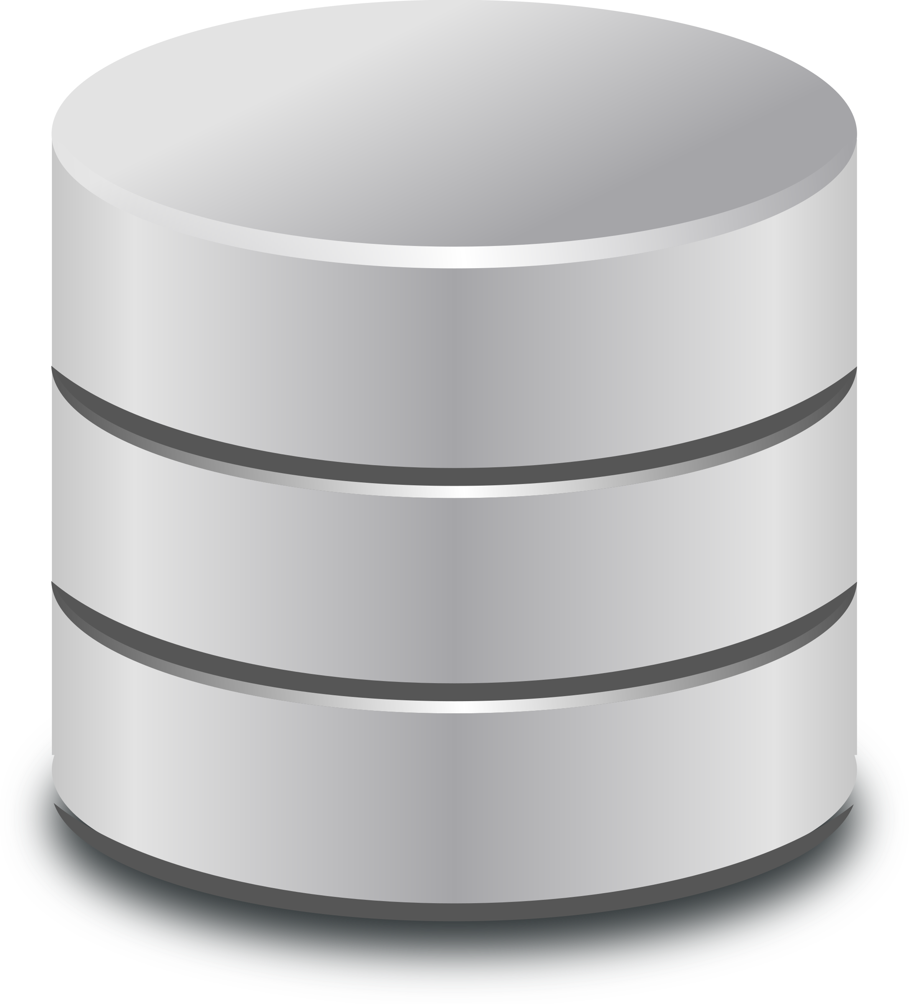
CI Relationships
In most cases, IT components (CIs) are not fully productive by themselves. CIs work together with other Cis in order to create value.
Notes:
Oftentimes, our business applications depend on a Database Management System and Database to provide the data we work with.

Slide 35
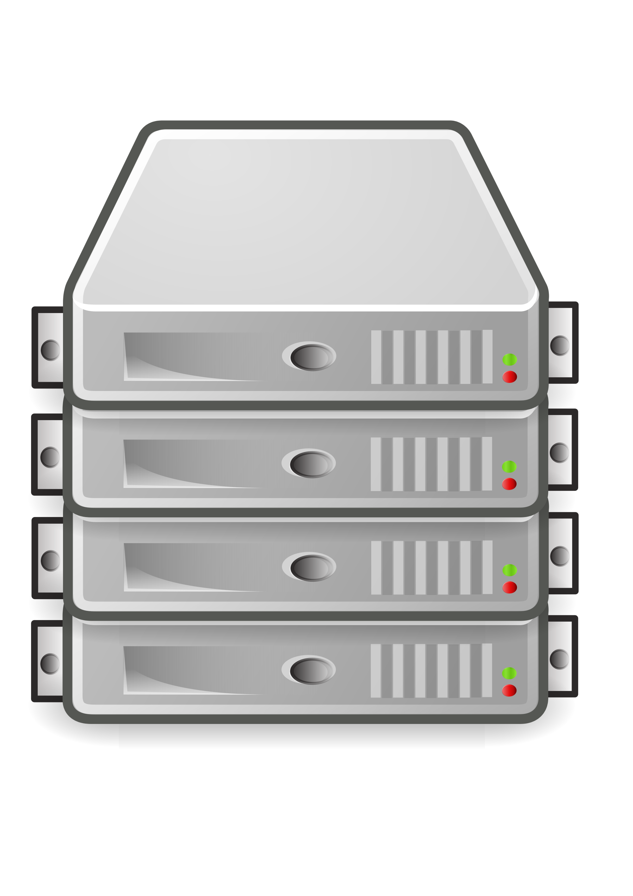
CI Relationships
In most cases, IT components (CIs) are not fully productive by themselves. CIs work together with other Cis in order to create value.
Notes:
In turn, that Database is likely running on a Server, located maybe in one of our company’s datacenters.

Slide 36
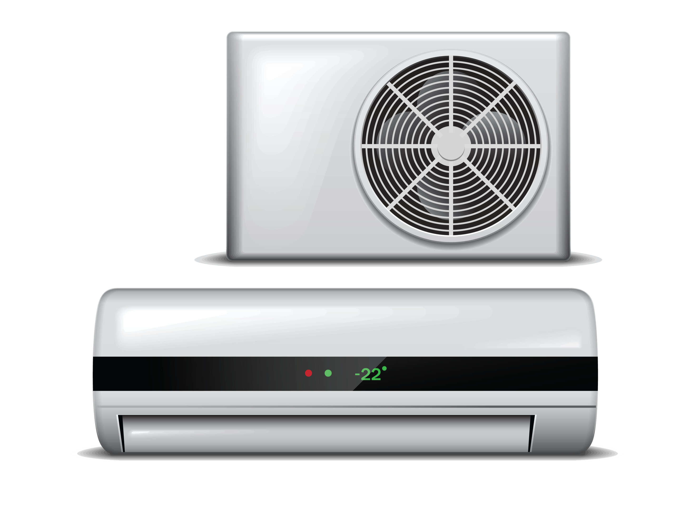
CI Relationships
In most cases, IT components (CIs) are not fully productive by themselves. CIs work together with other Cis in order to create value.
Notes:
And that Server will depend on racks, and power supplies, and cooling units.
In order to make our computer fully productive, a set of CI’s work together as a team.
In most cases, if any one of those CI’s fails, our computer loses its value.
A big part of Configuration Management includes the ability to understand these relationships.

Slide 37
CI Relationships
Connected by :: Connects
Consumed by :: Consumes
Contained by :: Contains
Cooled by :: Cools
Depends on :: Used by
Fed by :: Feeds
Hosted on :: Hosts
Managed by :: Manages
Owned by :: Owns
Powered by :: Powers
Runs on :: Runs
Used by :: Uses
Notes:
For that reason, the ServiceNow CMDB comes OOB with a robust set of relationship types that allow us to link Cis together and create a real-world picture of how our IT Assets depend on each other to create value.
This slide shows just a small subset of the available relationship types.

Slide 38
CI Relationships
In most cases, IT components (CIs) are not fully productive by themselves. They work together with other Cis in order to create value.
Runs ::
Runs on
Uses ::
Used by
Runs on::
Runs
Depends on ::
Used by
Cooled by ::
Cools
Notes:
Using them, we can build a real-world depiction of how our IT Assets are working together and depending on each other to provide value to the company and its customers.
(STOP)

Slide 39

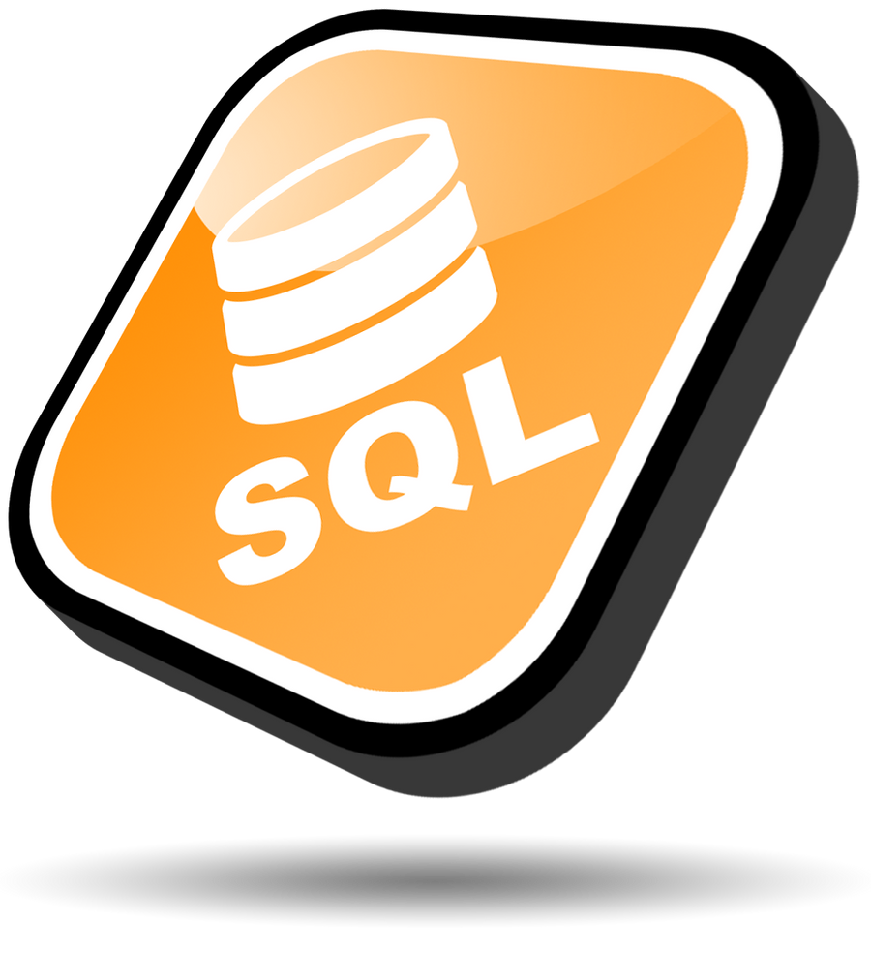
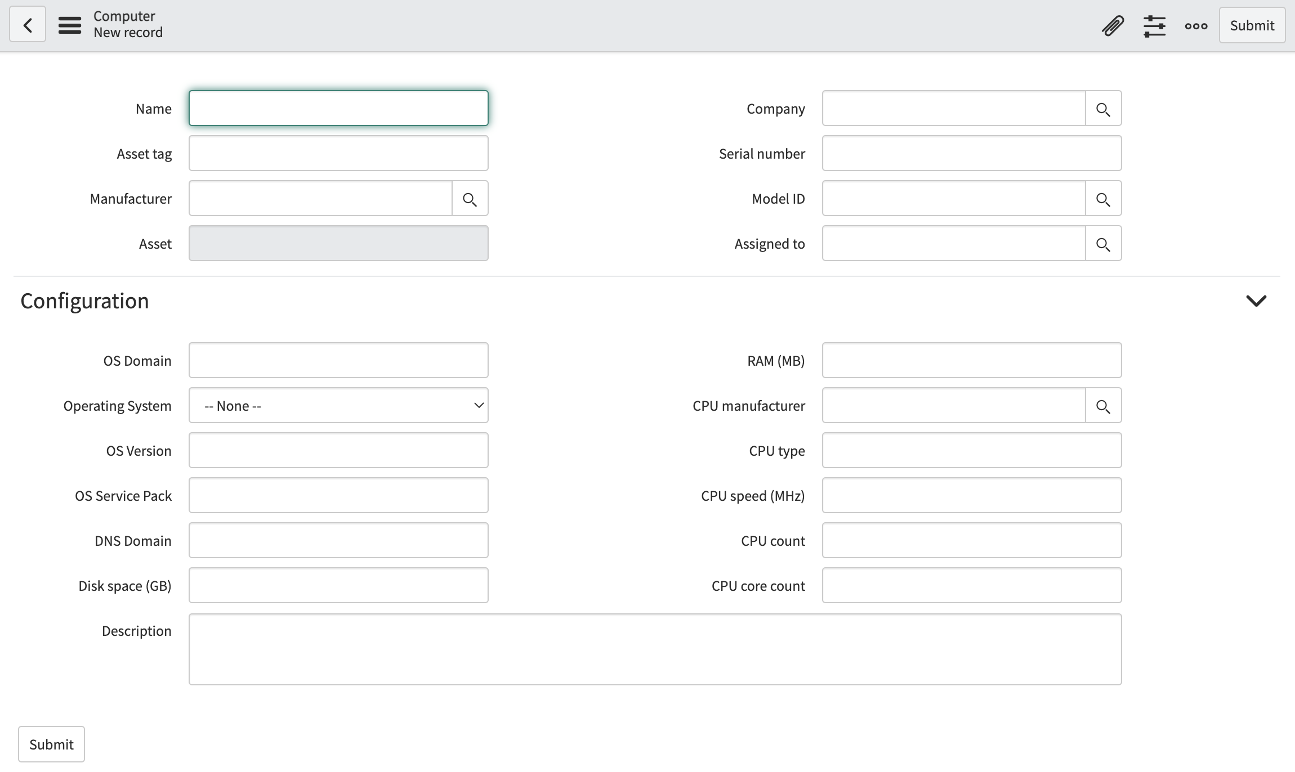
How does the CMDB get populated?
Imports / Integrations
Manual Entry
Auto Detection
Discovery
Service Mapping
CMDB
Notes:
So, how do all these CIs and relationships get populated into the CMDB?
Primarily through three channels.
First, ServiceNow provides forms and lists for each table allowing users to manually insert, update, and delete CI’s. As you can imagine, manual entry of CI’s and relationships is time-consuming and error-prone. When first starting out, however, many companies begin with some level of manual entry, and some types of CI’s will always require manual entry and maintenance.
Another method of populating CI’s into the CMDB is through the use of imports or integrations. Oftentimes, a company will have existing databases or spreadsheets that are being used to track software and hardware. When those exist, ServiceNow’s importing tools can be used to build integrations that pull data from existing sources and load into the CMDB. Those integrations can then be scheduled to run on a regular basis to reconcile changes that continue to occur in the legacy data source.
Finally, automated detection tools, like ServiceNow’s Discovery and Service Mapping applications, can be used to scan a company’s networks, identify hardware and software components, and load them into the CMDB automatically. This method of CI population provides a highly efficient, repeatable, and accurate source of CI and CI relationships data.

Slide 40
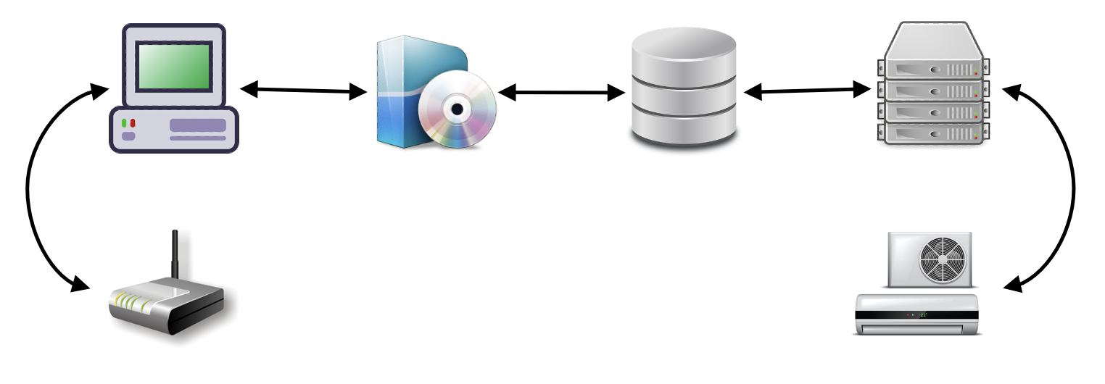
Services in the CMDB
Notes:
So, a CMDB stores IT Assets and the relationships between those assets, and earlier in the video, I asked you to think of IT Assets as Hardware and Software.
Now, I want you to expand your concept of IT Assets.
Business operations, and businesspeople don’t really care about Servers, Routers, and Database Instances.
They care about the IT services they use to run operations, engage customers, drive revenues, increase efficiency, and create new business opportunities.

Slide 41

Services in the CMDB
Service CI
Service CI
Service CI
Email
Ordering
Payroll
Notes:
For that reason, we need to expand our definition of IT Assets to include things that are less physical, and more logical. Things like Services. Email, Order Processing, or Payroll, for example.
Services, like these, are also tracked in the CMDB, to bridge the gap between the Hardware and Software CI’s and the actual value they are producing to IT’s customers or tenants.

Slide 42

Services in the CMDB
Email
Ordering
Payroll
Notes:
They get us one step closer to the people that are actually benefiting from IT.

Slide 43
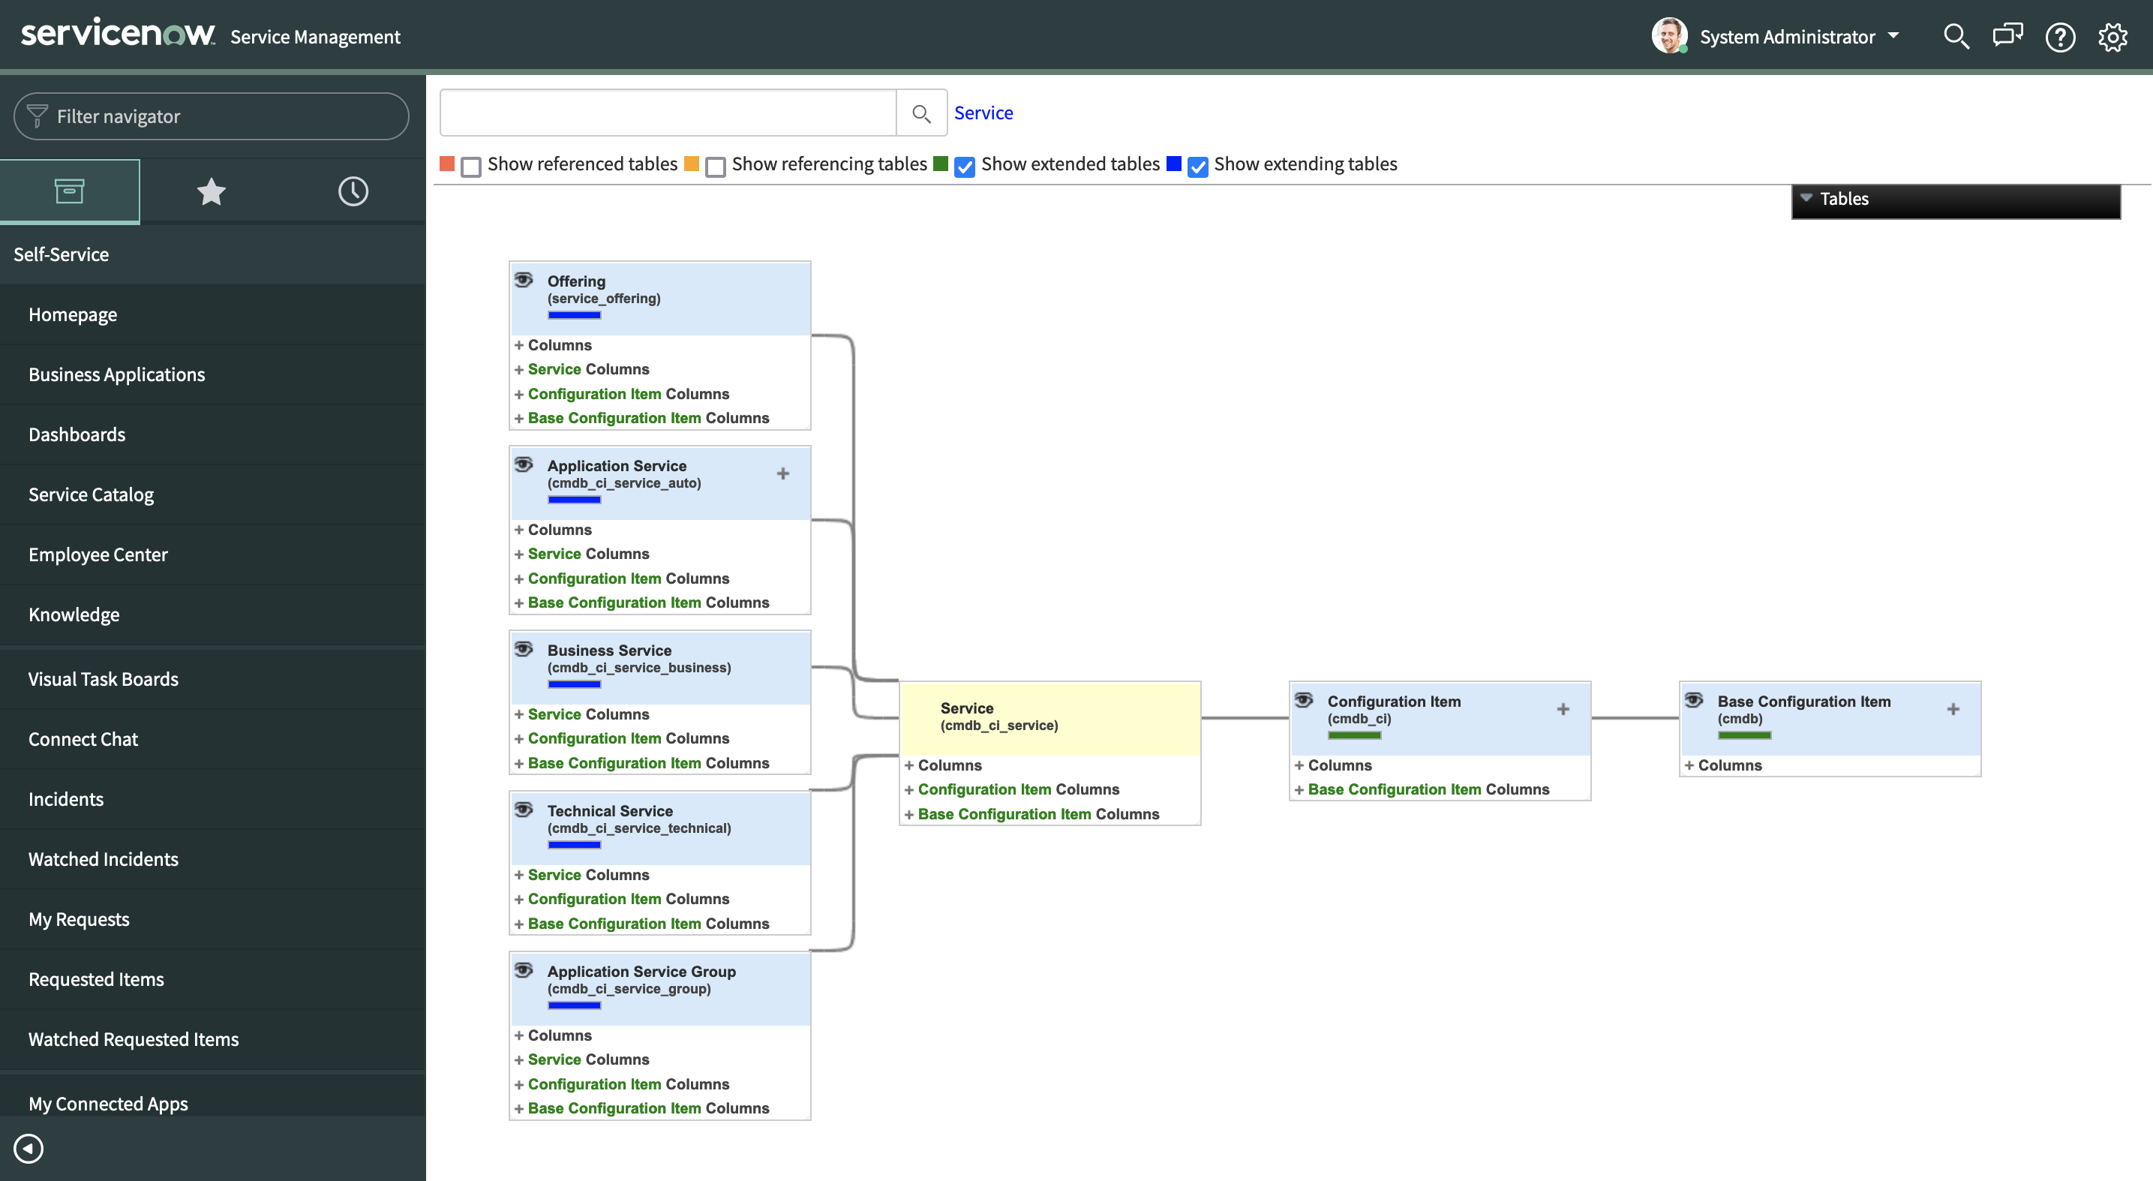
Services in the CMDB
Notes:
The ServiceNow CMDB comes equipped with a class hierarchy and set of tables designed specifically for managing logical entities like Service Offerings, Application Services, Business Services and Technical Services.
(STOP)

Slide 44
ServiceNow’s CMDB
ServiceNow
Notes:
In a prior video entitled ‘What is ServiceNow’,
which, you should watch, if you haven’t,
I defined ServiceNow as a cloud-based Application Platform as a Service that provides the infrastructure and applications needed to allow businesspeople to solve business problems themselves.
It’s a company’s IT department, in the cloud.

Slide 45
ServiceNow’s CMDB
ServiceNow
Notes:
(Ding)

Slide 46
ServiceNow’s CMDB
ServiceNow
CMDB
Notes:
One of the great things about the ServiceNow platform is that it has been designed around the CMDB.
CMDB is not an afterthought. It is the heart and soul of ServiceNow’s database.
ServiceNow is, CMDB-centric!

Slide 47
ServiceNow’s CMDB
ServiceNow
Incident
CMDB
Notes:
Functions like Incident Management,

Slide 48
ServiceNow’s CMDB
ServiceNow
Incident
CMDB
Problem
Notes:
Problem Management

Slide 49
ServiceNow’s CMDB
ServiceNow
Incident
CMDB
Problem
Change
Notes:
Change Management,

Slide 50
ServiceNow’s CMDB
ServiceNow
Operations
Incident
CMDB
Problem
Change
Notes:
and Operations Management, are all built to work directly with the CMDB, CI’s and relationships.
(STOP)

Slide 51
CMDB

