Slide 1
Let’s Login!
ServiceNowSimple

Slide 2
Agenda
Login: Your URL, What is an Instance?, APAAS, UI Types, Database
User Administration: Users, groups, roles
Navigation: All, Favorites, History, Workspaces, Context Pill, Global Search, Embedded Help, Notifications, User Menu (personalization)
Workflows: IT, Employee, Customer, Creator
Common UI Elements: Workspaces, Lists, Forms, Dashboards, Knowledge Articles, Service Catalog
Useful Resources: Now Learning, ServiceNow Community, ServiceNow Developer Site, PDI
Tasks
Reporting
Knowledge Management
Service catalogf
Virtual Agent

Slide 3
ServiceNow Platform
Cloud-based Application Platform as a Service (APaaS)
NOW Platform
Infrastructure
Platform
Applications /
Workflows
NOW
Platform UI
ServiceNow
Mobile Apps
Notes:
What a great idea! But How. How, ServiceNow?
The Now Platform is a cloud-based Application Platform as a Service (APaaS) that provides the infrastructure, platform, and applications and workflows required to support a businesses IT needs.
Businesspeople can connect to and utilize the platform from their PC’s or mobile devices.

Slide 4
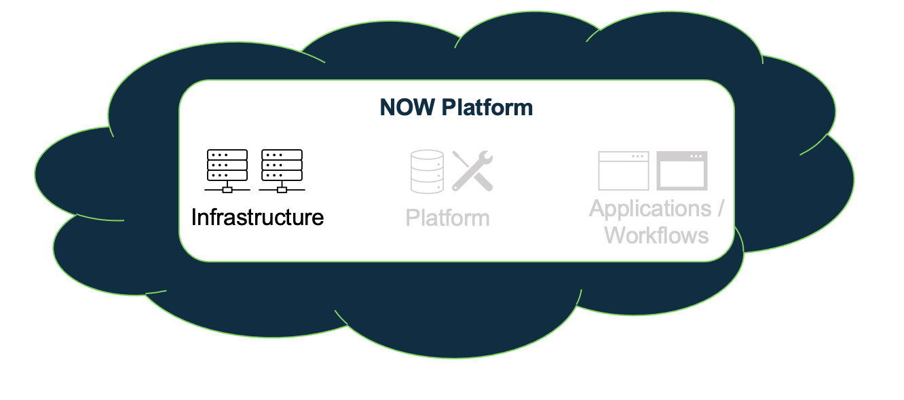
ServiceNow Platform
Infrastructure
Compute Resources: Datacenters, racks, servers, ports, network resources, fans, etc.
Security: The platform is secured via multiple technologies which have been certified by third-party security organizations
Service Level Agreements: Paired datacenters provide redundancy and failover; Redundancy is built into every layer including devices, power, and network resources
Backups: 4 daily full backups per week and 6 days of daily differential backups
Notes:
ServiceNow’s infrastructure includes all the Compute Resources.
It also includes the Security, both physical and virtual, secured via multiple technologies and continually audited and certified by third-party security organizations.
Redundancy and failover are also taken care of by the platform, with redundancy built into every layer from devices and network resources to paired datacenters that span the globe.
Data backups are also included with 4 daily backups each week and 6 days of differential backups per week.

Slide 5
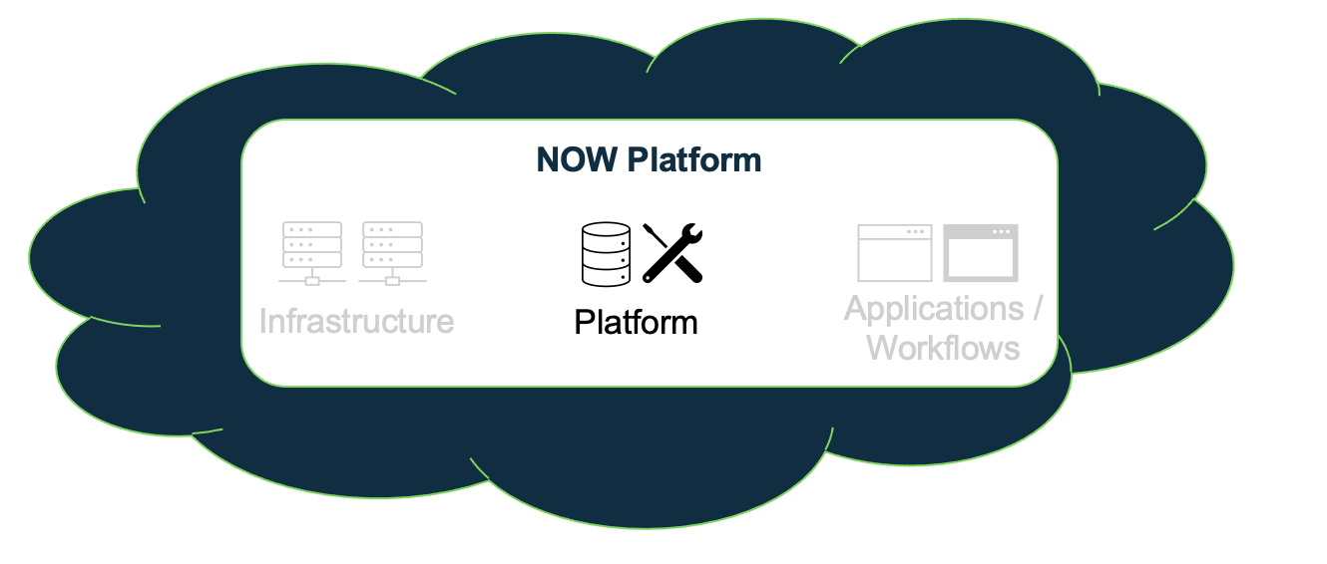
ServiceNow Platform
Platform
All applications (OOB and custom) for the entire enterprise are supported by a single, common, data-model and database
Ability to develop custom applications and workflows that integrate seamlessly into the platform
Notes:
The platform is underpinned by a single enterprise-wide data model and database.
It comes OOB with a robust data model and set of tables that can support most IT functions.
The platform also supports the ability to create your very own custom workflows or applications as needed. All running atop a single source of data and seamlessly integrated into the platform.

Slide 6
ServiceNow Instance
Prod Instance
Web Browser
Notes:
What a great idea! But How. How, ServiceNow?
The Now Platform is a cloud-based Application Platform as a Service (APaaS) that provides the infrastructure, platform, and applications and workflows required to support a businesses IT needs.
Businesspeople can connect to and utilize the platform from their PC’s or mobile devices.

Slide 7
ServiceNow Instance
Prod Instance
Test Instance
Web Browser
Notes:
What a great idea! But How. How, ServiceNow?
The Now Platform is a cloud-based Application Platform as a Service (APaaS) that provides the infrastructure, platform, and applications and workflows required to support a businesses IT needs.
Businesspeople can connect to and utilize the platform from their PC’s or mobile devices.

Slide 8
ServiceNow Instance
Prod Instance
Test Instance
Dev Instance
Web Browser
Notes:
What a great idea! But How. How, ServiceNow?
The Now Platform is a cloud-based Application Platform as a Service (APaaS) that provides the infrastructure, platform, and applications and workflows required to support a businesses IT needs.
Businesspeople can connect to and utilize the platform from their PC’s or mobile devices.

Slide 9
ServiceNow Instance
Prod Instance
Test Instance
Dev Instance
https://mycompany-prod.service-now.com
https://mycompany-test.service-now.com
https://mycompany-dev.service-now.com
Web Browser
Notes:
What a great idea! But How. How, ServiceNow?
The Now Platform is a cloud-based Application Platform as a Service (APaaS) that provides the infrastructure, platform, and applications and workflows required to support a businesses IT needs.
Businesspeople can connect to and utilize the platform from their PC’s or mobile devices.

Slide 10
Applications and Workflows
ServiceNow comes with a robust suite of applications which are categorized (functionally) into 4 primary workflows:
IT Workflows: 79 applications that support internal IT functions
Employee Workflows: 43 applications targeted at the needs of employees
Customer Workflows: 93 applications that support functions related to customers
Creator Workflows: 23 applications designed to enable ServiceNow platform development and operations support
ServiceNowSimple

Slide 11
Applications and Workflows
IT Workflows
IT Service Management (24)
IT Operations Management (13)
IT Business Management (10)
IT Asset Management (4)
DevOps (4)
Security Operations (8)
Governance, Risk, and Compliance (13)
Telecommunications Network Performance Management (3)
Employee Workflows
HR Service Delivery (16)
Workplace Service Delivery (10)
Legal Service Delivery (10)
Procurement Service Management (6)
Safe Workplace Suite (1)
Customer Workflows
Customer Service Management (29)
Field Service Management (11)
Connected Operations (4)
Financial Service Operations (25)
Telecommunications Service Management (24)
Creator Workflows
App Engine (15)
IntegrationHub (8)
ServiceNowSimple

Slide 12
End
ServiceNowSimple

