Slide 1
What is ServiceNow?
ServiceNowSimple

Slide 2
What is ServiceNow?
These slides and the associated video define ServiceNow by asking Who, What, Where, When, Why, and How.
I keep six honest serving-men
They taught me all I knew
Their names are What and Why and When
And How and Where and Who
- Rudyard Kipling
Notes:
Hey, it’s Jeff Thies here from ServiceNowSimple where we help you understand the ins-and-outs of ServiceNow, keeping it simple all the way.
If you’ve watched any of our videos, you’ve heard me say that before. In fact, it’s sort of become the go-to tagline for the ServiceNowSimple YouTube channel where we’re all about answering ServiceNow related questions in a manner that is simple and easy to understand.
But what if the Service-Now related question is, What is ServiceNow? We answer that question in this video short. (STOP)
There’s a phrase from a poem written by Rudyard Kipling that I love. It goes: (READ POEM)
Let’s take a look at Who, What, Where, When, Why and How to come to a conclusion on What is ServiceNow. And we’ll start with Who.

Slide 3
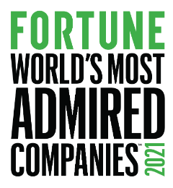
Who is ServiceNow?
Employees
ServiceNow employs over 17,000 people across the globe
In 2022, ServiceNow was recognized as one of Glassdoor’s Best Places to Work in both the United States and the UK.
In 2021, ServiceNow was one of FORTUNE magazine’s World’s Most Admired Companies, Future 50 companies, and 100 Best Companies to Work For
Notes:
And we’ll start with Who. Who is ServiceNow? It’s their employees. Over 17,000 people across the globe. And apparently, the like their jobs!
In 2022 ServiceNow was recognized as one of Glassdoor’s Best Places to Work, both in the United States and the UK.
In 2021, ServiceNow was one of FORTUNE magazine’s World’s Most Admired Companies, Future 50 Companies, and 100 Best Companies to Work For.

Slide 4
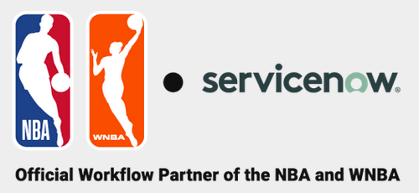
Who is ServiceNow?
Customers
ServiceNow targets mid to large-enterprise companies world-wide
Notes:
ServiceNow is also it’s Customers. The company targets mid to large-enterprises and its customers include the likes of (NAME THE COMPANIES)

Slide 5
Who is ServiceNow?
Bill McDermott
Currently serving as the CEO of ServiceNow
Formerly CEO of SAP SE where during his tenure the company’s market value increased from $39 billion to $156 billion
Notes:
Who else is ServiceNow? It’s Bill McDermott, who currently servers as the CEO. In his former position, Bill was the CEO of SAP where he grew that companies market value from $39 billion to $156 billion.

Slide 6
Who is ServiceNow?
Fred Luddy
ServiceNow founder and current board chairman
Born in New Castle, IN
Dropped out of Indiana University
Former CTO of Peregrine Systems
Notes:
And finally, ServiceNow is Fred Luddy, founder and current chairman of the company's board of directors. Fred was born in New Castle, IN and attended Indiana University. Fred loved to program! In fact, he loved it so much, he couldn’t pull himself away from his keyboard long enough to attend classes, so he eventually dropped out of college. He eventually worked his way up to becoming the CTO of a company named Peregrine Systems. Unfortunately, that company went bankrupt due to an incident involving accounting fraud and Fred lost his job and a great deal of this wealth.

Slide 7
When is ServiceNow?
2003: founds the company as GlideSoft
2006: Company name changed from GlideSoft to
2012: becomes a publicly traded company
2018: ServiceNow #1 on most innovative companies
2019: named CEO of ServiceNow
Notes:
Ok, that’s enough of Who. Let’s look at When. When is ServiceNow?
It all started in 2003, shortly after the bankruptcy of Peregrine Systems, when Fred founded a company named GlideSoft.
Then, 2006, when the company’s name was changed from GlideSoft to what we all know now as ServiceNow.
In 2012, ServiceNow became a publicly traded company under the ticker NOW.
2018, when ServiceNow is named #1 on FORBES magazine’s list of most innovative companies.
And 2019, when Bill McDermott is named as the company’s new CEO

Slide 8
Why ServiceNow?
Over the course of his career, had witnessed countless situations where Information Technology, its employees, and processes made smart businesspeople feel embarrassed and ignorant.
Notes:
Alright, but Why? Why ServiceNow?
For that, let’s watch a quick of one of my favorite skits from the American comedy series Saturday Night Live. (SHOW VIDEO)
I’ve been a member of Information Technology departments for over thirty years, and I’m embarrassed to say, there is a lot of truth in that skit.
I recently watched an interview where Fred Luddy was asked Why he had created ServiceNow. What was his real motivation behind the company. I loved what he said!
Fred explained that over the course of his career he had witnessed countless situations where IT, it’s processes, and staff had made intelligent businesspeople feel embarrassed and ignorant. Much like we just saw with Nick Burns, your company's computer guy.
This infuriated Fred, and he set out to fix a problem that existed in nearly all mid to large companies.

Slide 9
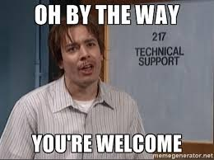
Why ServiceNow?
Information Technology (IT)
Usually does not produce revenue
Is an expense (oftentimes the largest)
Exists to enable or enhance the ability of the revenue-producing businesspeople
Is a necessary evil
Business
Solution / Service
Problem / Opportunity
IT
Notes:
In most cases, IT departments do not produce revenue. In fact, IT is an expense and oftentimes one of a company's greatest expenses. The IT department exists solely to enable or enhance the ability of the revenue-producing businesspeople. It’s a necessary evil!
To be successful, an exchange must occur between business operations and IT. The exchange of a business problem or opportunity with an IT Solution or Service.
Fred Luddy identified through his experience, that exchange was often frustrating, inefficient, or completely broken.
Smart businesspeople had to explain, and often re-explain business problem to IT staffers that were normally more interested in the technology than solving the business problem.

Slide 10
Why ServiceNow?
What if IT services were designed and delivered in a way that allowed businesspeople to solve business problems themselves?
Is it possible to build a platform where interacting with IT services is intuitive, well-delivered, and enjoyable to work with?
Let’s outsource the entire IT Department to the cloud and say goodbye to the IT guys of the world!
Notes:
He dared to dream.
What if IT services were designed and delivered in a way that allowed businesspeople to solve business problems themselves?
Is it possible to build a platform where interacting with IT services is intuitive, well-delivered, and enjoyable to work with?
Let’s outsource the entire IT Department to the cloud and say goodbye to the Nick Burns IT guys of the world!
ServiceNow is your company’s IT department in the cloud! That’s it’s why! It’s reason for being!

Slide 11
How ServiceNow?
Cloud-based Application Platform as a Service (APaaS)
NOW Platform
Infrastructure
Platform
Applications /
Workflows
NOW
Platform UI
ServiceNow
Mobile Apps
Notes:
What a great idea! But How. How, ServiceNow?
The Now Platform is a cloud-based Application Platform as a Service (APaaS) that provides the infrastructure, platform, and applications and workflows required to support a businesses IT needs.
Businesspeople can connect to and utilize the platform from their PC’s or mobile devices.

Slide 12
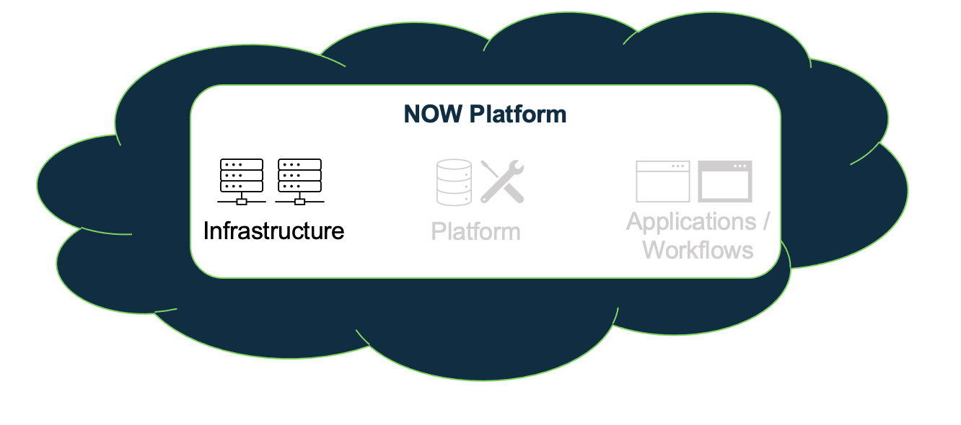
How ServiceNow?
Infrastructure
Compute Resources: Datacenters, racks, servers, ports, network resources, fans, etc.
Security: The platform is secured via multiple technologies which have been certified by third-party security organizations
Service Level Agreements: Paired datacenters provide redundancy and failover; Redundancy is built into every layer including devices, power, and network resources
Backups: 4 daily full backups per week and 6 days of daily differential backups
Notes:
ServiceNow’s infrastructure includes all the Compute Resources.
It also includes the Security, both physical and virtual, secured via multiple technologies and continually audited and certified by third-party security organizations.
Redundancy and failover are also taken care of by the platform, with redundancy built into every layer from devices and network resources to paired datacenters that span the globe.
Data backups are also included with 4 daily backups each week and 6 days of differential backups per week.

Slide 13
How ServiceNow?
Platform
All applications (OOB and custom) for the entire enterprise are supported by a single, common, data-model and database
Ability to develop custom applications and workflows that integrate seamlessly into the platform
Notes:
The platform is underpinned by a single enterprise-wide data model and database.
It comes OOB with a robust data model and set of tables that can support most IT functions.
The platform also supports the ability to create your very own custom workflows or applications as needed. All running atop a single source of data and seamlessly integrated into the platform.

Slide 14
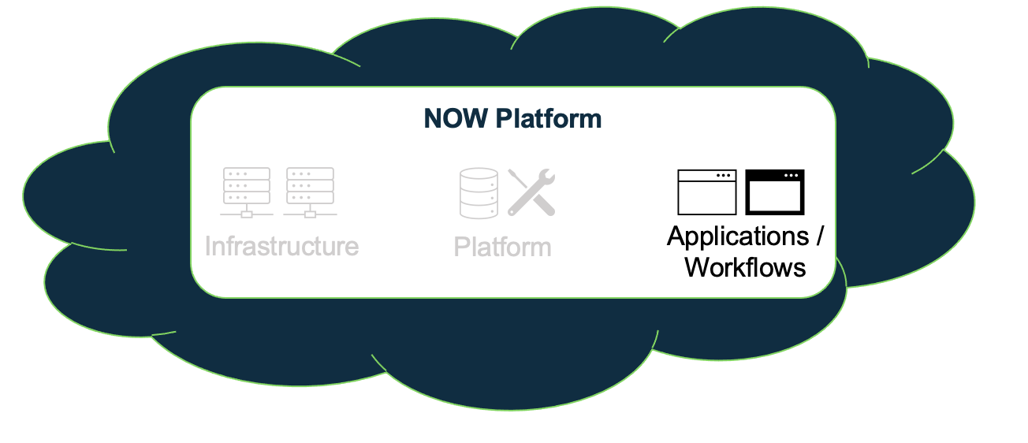
How ServiceNow?
Applications / Workflows
ServiceNow comes with a robust suite of applications which are functionally categorized into 4 primary workflows:
IT Workflows: Service Management (24), Operations Management (13), Business Management (10), Asset Management (4), DevOps (4), Security Operations (8), Governance, Risk, and Compliance (13), Telecommunications Network, Performance Management (3)
Employee Workflows: HR Service Delivery (16), Workplace Service Delivery (10), Legal Service Delivery (10), Procurement Service Management (6), Safe Workplace Suite (1)
Customer Workflows: Customer Service Management (29), Field Service Management (11), Connected Operations (4), Financial Service Operations (25), Telecommunications Service Management (24)
Creator Workflows: App Engine (15), IntegrationHub (8)
Notes:
Finally, the platform includes an amazingly broad range of applications and workflows, pre-built and ready to use.
ServiceNow categorizes applications functionally, based upon the type of work being supported. The categories include IT Workflows, Employee Workflows, Customer Workflows, and Creator Workflows.
Those categories are then subdivided into subcategories targeting the specific needs of the company. This slide shows the number of applications in the parenthesis beside each subcategory.
And remember, if you can’t find an OOB application that supports your businesses unique requirements, you can build one yourself, right within the platform itself.

Slide 15
Where ServiceNow?
Headquarters: Santa Clara, California
Office Locations & Employees: Across the globe including North America, Latin America, Europe, Middle-East, Africa, Asia Pacific, Japan
Data Centers:
Asia Pacific Japan: Australia, Hong Kong, Japan, Singapore, India
Europe, Middle East, Africa: Germany, Ireland, Netherlands, Switzerland, UK
North America: Canada, USA
South America: Brazil
Notes:
So, that’s an overview of How ServiceNow works. Let’s end by looking at Where. Where ServiceNow?
The company’s is based out of Santa Clara, CA, but has offices and employees spread across the globe including: (READ SLIDE)
The datacenters that support the platform and its redundancy are spread throughout: (READ BOLD LOCATIONS)

Slide 16
What is ServiceNow?
ServiceNow is a software company based in Santa Clara, California, founded by Fred Luddy in 2003, to solve problems large enterprises face with traditional IT delivery by providing a robust, simple to use, cloud-based environment in which businesspeople can solve the business problems themselves.
- ServiceNowSimple working definition
Notes:
So that’s it, Who, What, Where, When, Why, and How ServiceNow.
Now, let’s attempt a single-sentence answer to the original question, What is ServiceNow?
(READ DEFINITION)
If you’ve found this video helpful, let us know with a thumbs up and subscribe to the channel.
We’d love to hear you definition of ServiceNow! Maybe we missed something and can improve ours. Tell us what you think in a comment!
But remember, keep it simple! ServiceNowSimple!

